Slide 1
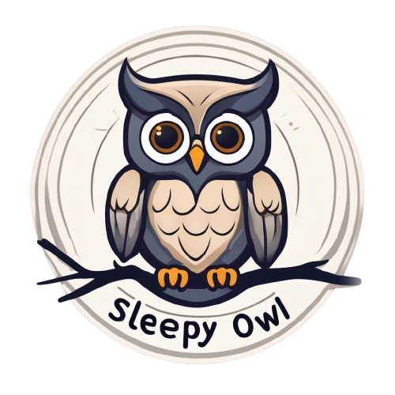
Your Sleep Assistant
Sleep well, be health

Slide 2




Problem
40%
5%
Approximately 40% of the world’s population suffers from sleep problems, although only 5% seek medical attention for this.

Slide 3

Our Solution
Chat-Bot Assistant “Sleepy Owl”
It will help you solve your sleep problems, based on your input and your Personal Information(Age, Gender and etc).
Also you can enter amount of sleep, your schedule, hobbies and diet.

Slide 4

Market size
30% of adults in Moldova experience sleep problems.
600.000
*According to the National Institute of Public Health of Moldova
Potential users:
420.000
Achievable Users:
12.600
Audience:
Students
Laborers
Parents
Travelers
Moldova is the start zone of our project before global release.

Slide 5
Competitors
Sleep Apps
Sleep Aura
Calm
Sleepy Owl
Non-AI
ChatGPT
Bard AI
AI
General Apps

Slide 6
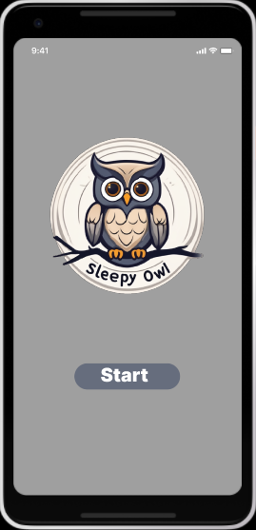
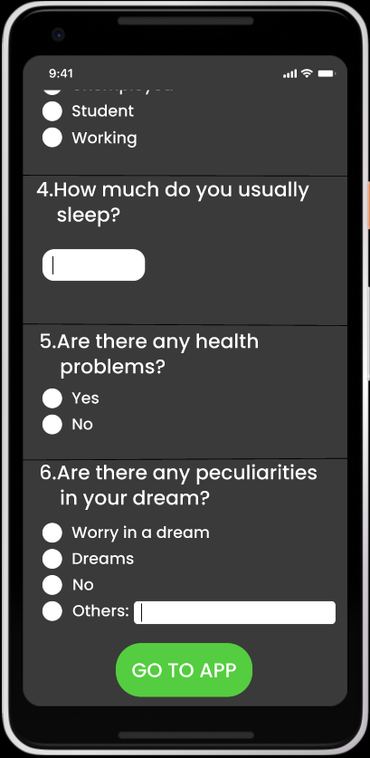
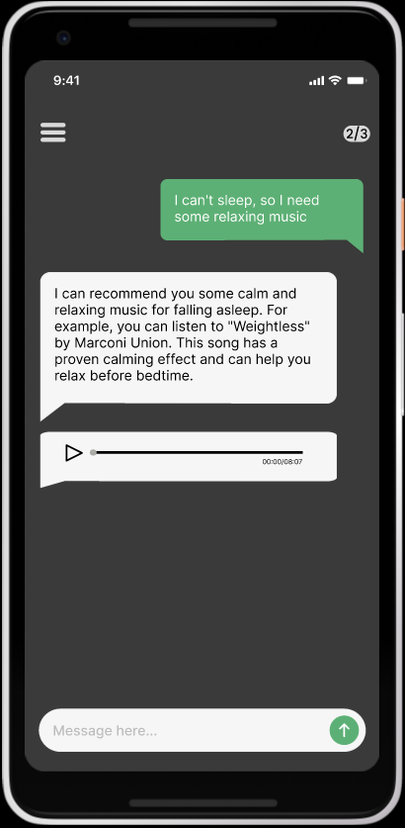
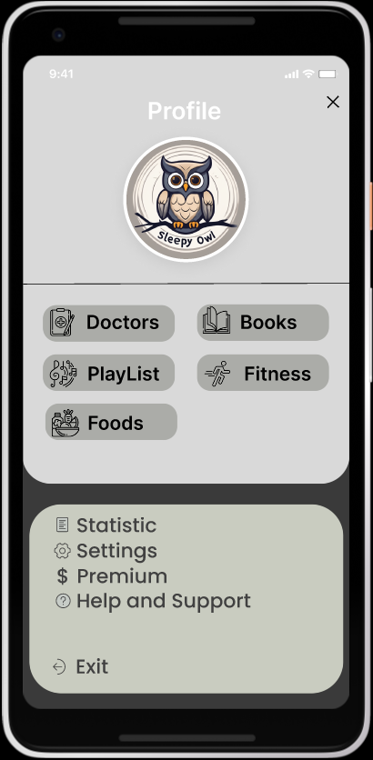
App Prototype

Slide 7
Business Model
Premium Subscription
2.99$
a month
Exclusive
Content
Access to book library and playlist without chat
$1.99
A month
Free version
10 free questions per week, watch ads to unlock more questions

Slide 8




Expenses
Developers salary $24k for 6 month
Creating Our Own AI $2k
Content $5k
Infrastructure $1k
Total Cost: 32k

Slide 9

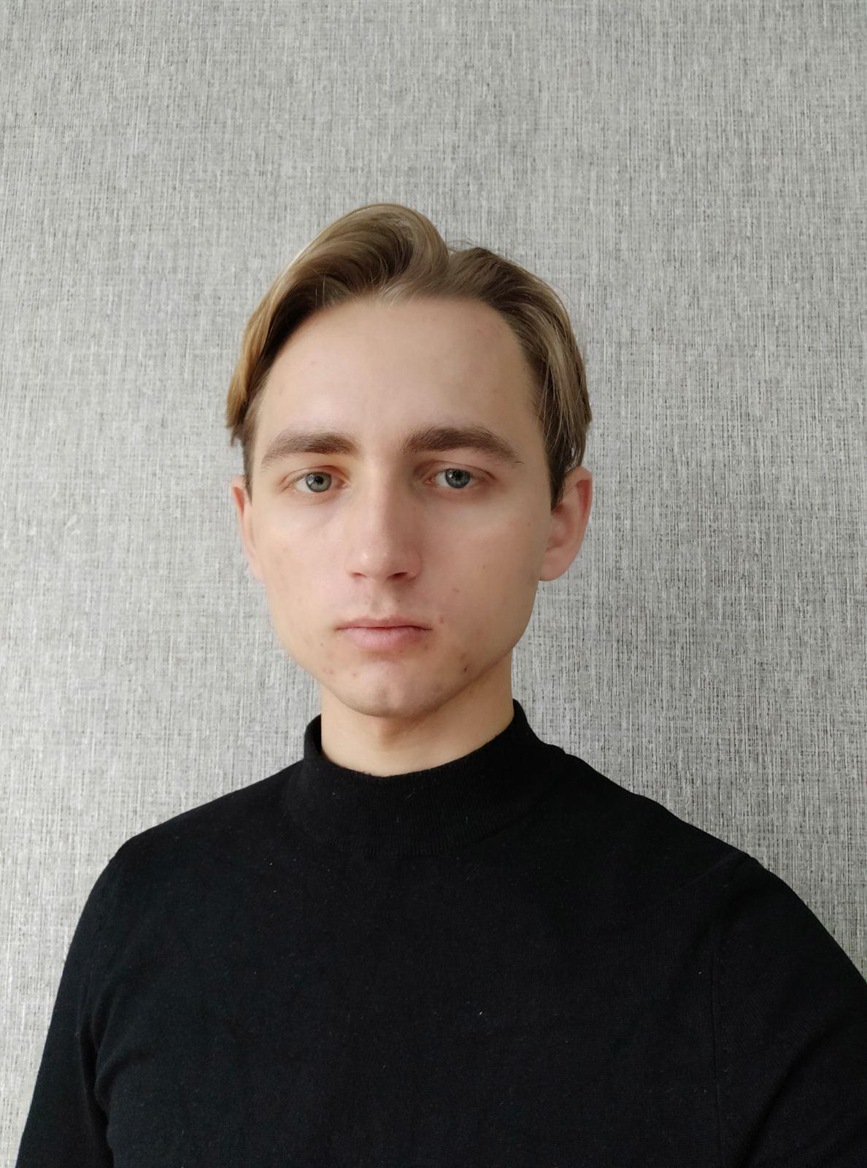
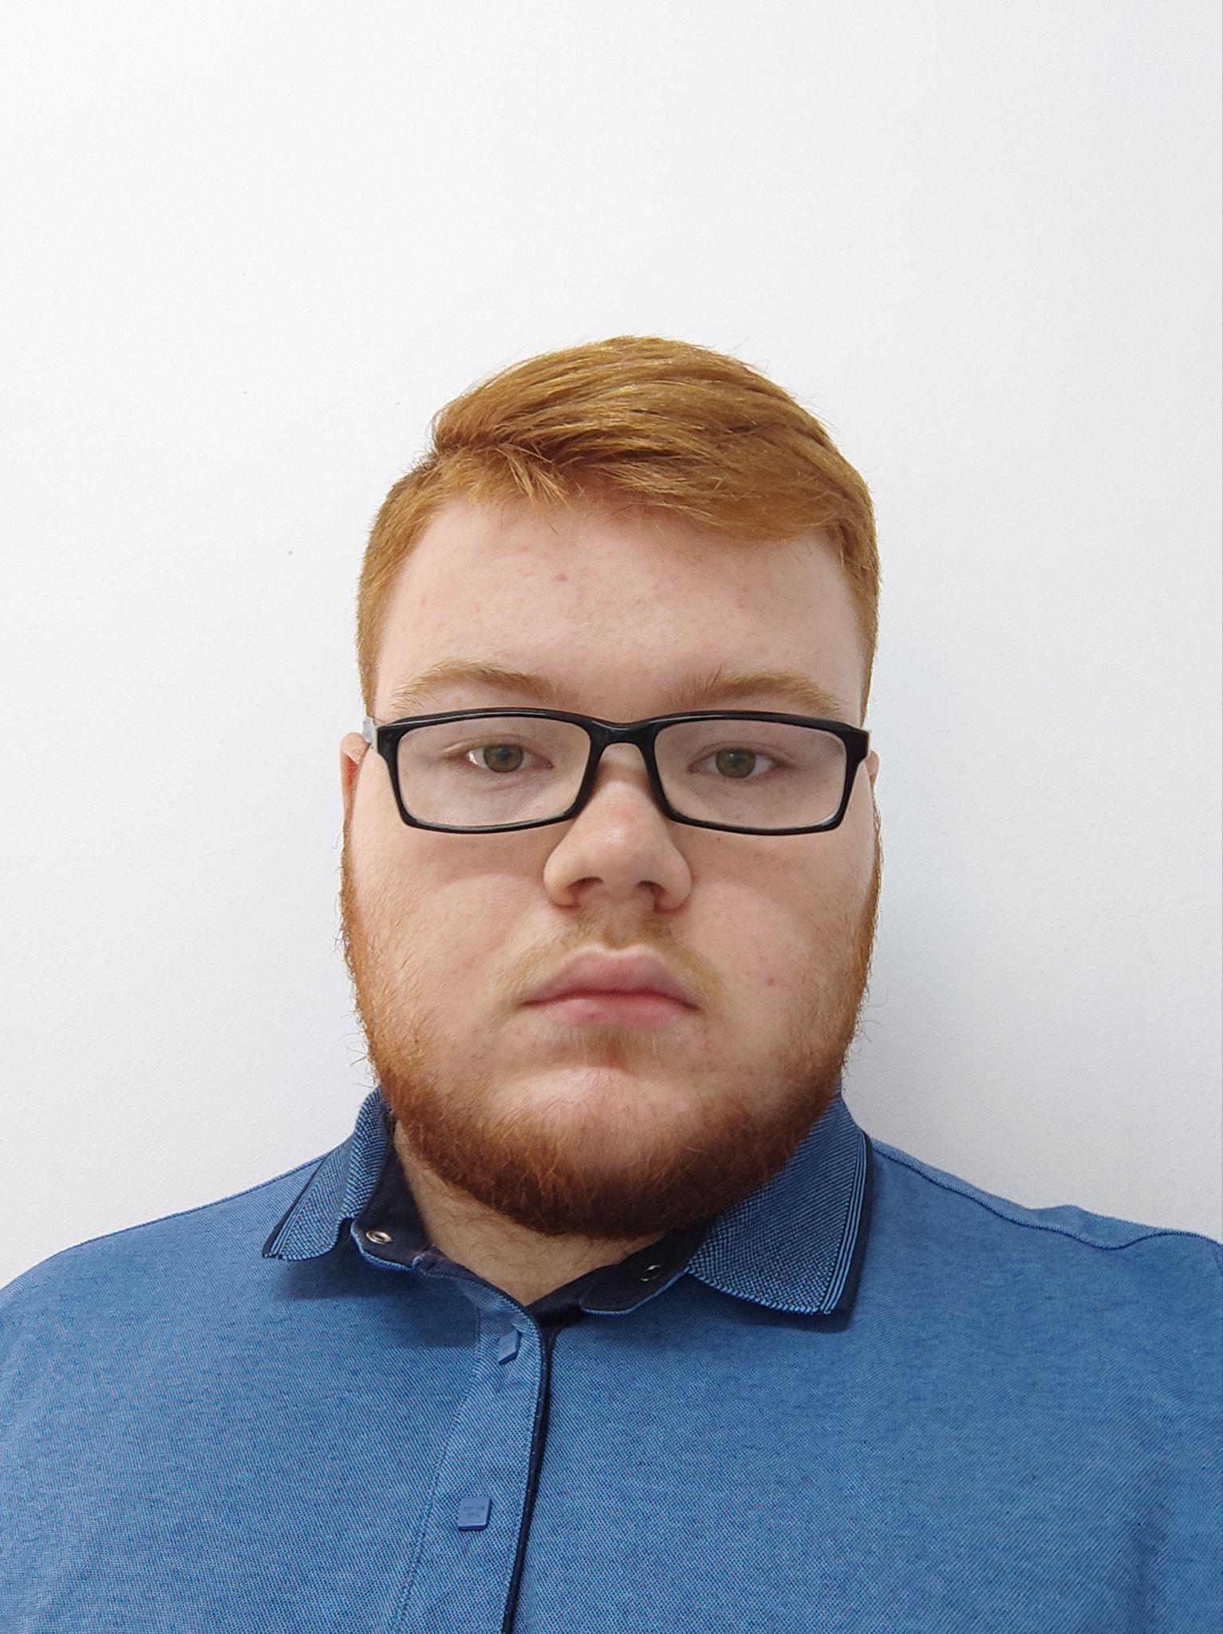
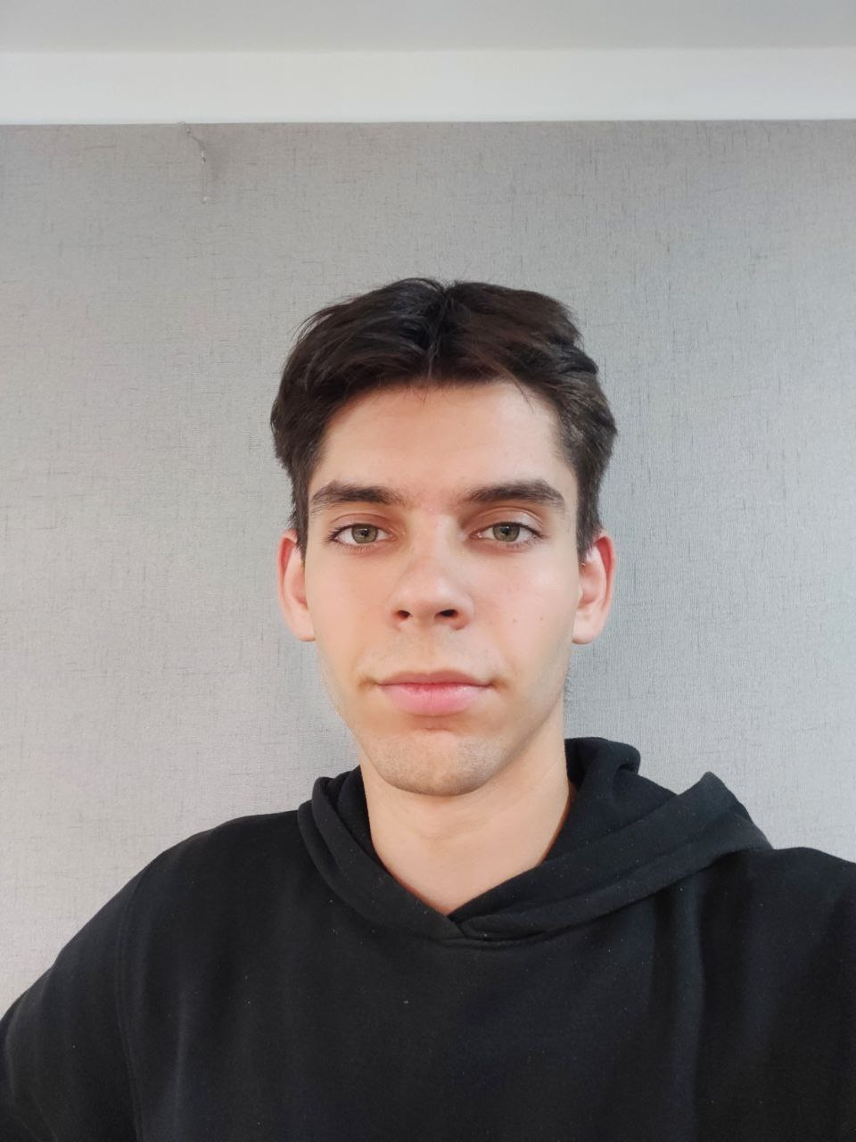
Our Team
Nadejda Dmitrieva
Marin Șamurai
Mihai
Lungu
Pavel
Kurkin
Project Manager
UX/UI designer
Software Engineering Developer
Brand Manager

Slide 10
Timeline
20-22
October
2023
March
2024
April
2024
Structuring the Idea and Creating a Prototype
Application Development
Launching The Application

Slide 11
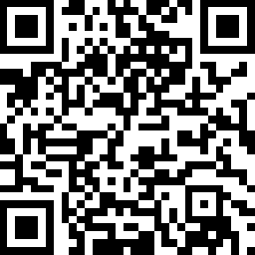
Thank You For Attention!!
QR-Code Bot Telegram
Demo Version

